Slide 1


Slide 2
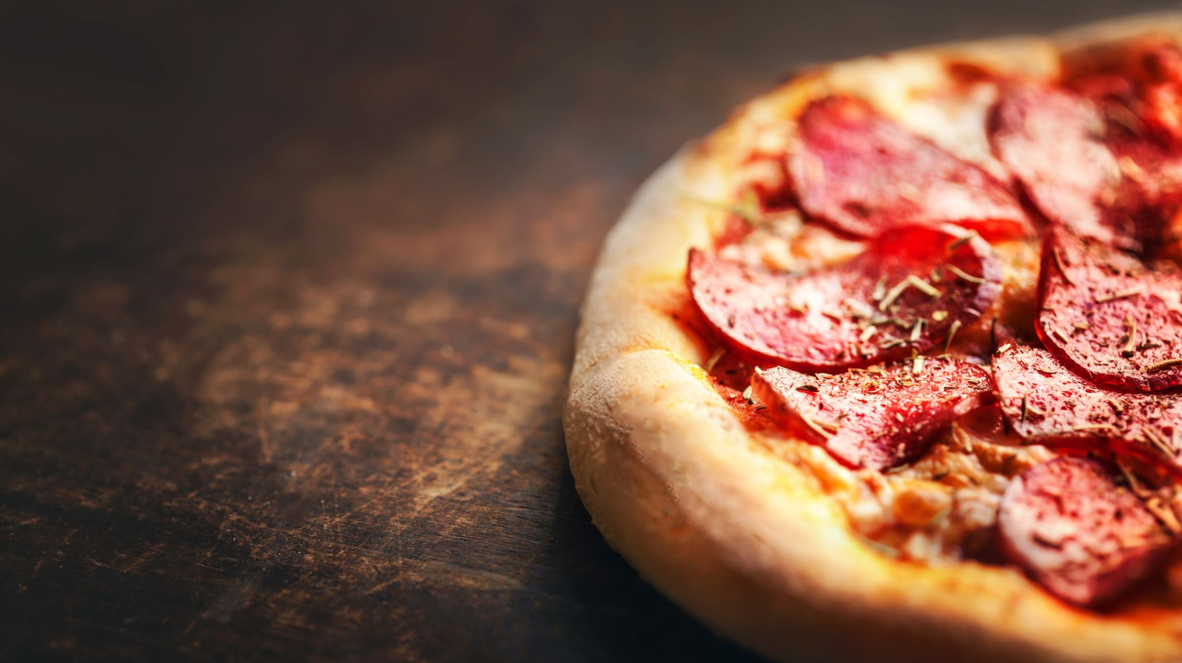
Essential Details
Overall number of orders received
21,338
Total income generated from pizza sales
$476,552
Most expensive pizza
The Greek Pizza: $36.00
Average pizzas ordered daily
138

Slide 3
The rankings of the top five pizzas reveal minimal variation, with fewer than 100 orders distinguishing the Classic Deluxe from the Thai Chicken Pizza, suggesting stable popularity.
The selection of pizzas in the top 5, which features Hawaiian, Thai Chicken, and Pepperoni, showcases a broad spectrum of customer tastes, encompassing both traditional and unique flavors.

Slide 4
Medium-sized pizzas (M) account for 15,635 sold (11,159 orders), while Small (S) pizzas total 14,403 sold (10,490 orders), indicating similar popularity and warranting their continued promotion. In contrast, XL pizzas have only 552 sold (544 orders), and XXL pizzas just 28 sold (28 orders), suggesting low demand for these larger sizes, possibly due to pricing, portion size, or misalignment with customer preferences.

Slide 5
A noticeable difference exists between Classic pizzas and the other three categories, with about 3,000 additional orders for Classics. This suggests that although diversity is valued, Classic pizzas continue to evoke a sense of nostalgia and enduring appeal.

Slide 6
Balanced Demand
The minor discrepancies in revenue suggest that customers are drawn to all three chicken pizzas in equal measure, likely due to a well-curated menu and consistent popularity among the options.

Slide 7
Prevalence of Specialty Chicken:
Chicken pizzas lead the revenue distribution, occupying the highest ranks. This trend indicates a strong customer preference for chicken-based pizzas, particularly those featuring distinctive or fusion flavor combinations.
Pizzas like Greek (0.67%), Five Cheese (0.59%), and others contributing less than 2% to revenue reflect limited customer interest. This underscores potential opportunities for menu modifications or promotional strategies aimed at boosting these items.

Slide 8
Stable Revenue with Minor Variations
The revenue demonstrates a consistent pattern over the months, remaining in the vicinity of $40,000. This indicates a stable customer demand and a dedicated clientele.
Certain months (such as January, April, July, and October) report revenues close to $41,000. This indicates reliability, though it also points to a stagnation in notable growth.

Slide 9
The 3 Most Popular Pizza Types by Revenue in Each Category
Chicken Pizza Revenue:
The Thai Chicken Pizza leads with $43,434.25, followed by the Barbecue Chicken Pizza at $42,768.00 and the California Chicken Pizza with $41,409.50, indicating their importance to overall sales.
Classic Pizza Demand:
In the Classic category, the Pepperoni Pizza generates $19,598.00, while the Greek Pizza lags significantly at $3,018.39, reflecting a notable performance gap.
Veggie Sales Performance:
The Four Cheese Pizza tops the Veggie category with $32,265.70, showing strong demand for vegetarian options, while other choices like the Italian Vegetables Pizza have room for growth.
Piza type | Pizza Name | Revenue (Top 3)
Chicken | The Thai Chicken Pizza | $ 43434.25
Chicken | The Barbecue Chicken Pizza | $ 42768.00
Chicken | The California Chicken Pizza | $ 41409.50
Classic | The Pepperoni Pizza | $ 19598.00
Classic | The Hawaiian Pizza | $ 8987.10
Classic | The Greek Pizza | $ 3018.39
Supreme | The Sicilian Pizza | $ 30940.50
Supreme | The Spicy Italian Pizza | $ 24193.70
Supreme | The Italian Supreme Pizza | $ 17297.90
Veggie | The Four Cheese Pizza | $ 32265.70
Veggie | The Mexicana Pizza | $ 17648.99
Veggie | The Italian Vegetables Pizza | $ 12069.15

Slide 10
Recommendations
At specific times, such as around noon on January 1st and 2nd, there is a noticeable surge in orders, suggesting that customers may be placing orders during breaks or social events. This underscores the importance of efficient processing during these peak periods.
Off-peak Times: Early morning (before 11:30 AM) and mid-afternoon (3:00–5:00 PM) tend to have lower activity levels, creating opportunities for targeted promotions to increase sales during these quieter times.
Given the popularity of certain pizzas, consider experimenting with small price increases, limited-time offers, or premium options featuring extra toppings.
Utilize targeted marketing to promote the Thai Chicken, Barbecue Chicken, and California Chicken Pizzas as primary offerings to enhance their attractiveness.
Reevaluate pizzas that account for less than 2% of revenue. Consider strategies such as reformulating, repackaging, or implementing limited-time promotions to gauge customer interest.

